Slide 1
DECEMBER 2019

Slide 2
“We are reasonably confident that US growth is improving…the sharp drop in mortgage rates has reinvigorated the housing recovery after a slowdown in 2018 and early 2019. The structural outlook is also strong, as the level
of building activity remains well
below demographic demand.”
Goldman Sachs
Notes:
https://www.housingwire.com/articles/goldman-sachs-predicts-global-expansion

Slide 3
Home Prices Projected to Continue to Appreciate
Source | 2019 | 2020 | 2021 | 2022
Home Price Expectation Survey | +3.6 | +2.5 | +2.2 | +2.7
Mortgage Bankers Association | +4.3 | +3.1 | +2.2 | N/A
Zelman & Assoc. | +3.9 | +3.7 | +3.3 | N/A
Fannie Mae | +5.2 | +4.1 | +2 | N/A
National Association of Realtors | +4.3 | +3.6 | N/A | N/A
Freddie Mac | +3.3 | +2.8 | N/A | N/A
Notes:
www.freddiemac.com
www.fanniemae.com
www.nar.realtor/
www.pulsenomics.com
www.mba.org
www.zelmanassociates.com (subscription required)
wsj.com (subscription required)

Slide 4
Mortgage Rates
Freddie Mac 30-Year Fixed Rate
Where Are They Going?
January 2018 – Today Actual Interest Rates
Q1
Q2
Q3
Q4
2020
Freddie Mac
Notes:
http://www.freddiemac.com/research/forecast/20191127_housing_market_continues_to_stand_firm.page?

Slide 5
Buyer Purchasing Power INCREASING!
Market Factor | Change | Impact on Buyers’ Purchasing Power
Home Prices | +5.7% | -$21,300
Mortgage Rates | -.85 | +$40,200
Wages | +1.5% | +$5,600
Total Impact on Purchasing Power
+$24,500
First American
Notes:
https://blog.firstam.com/economics/the-dynamic-forces-that-re-shaped-housing-affordability-in-2019

Slide 6
Q: When do most listings
come on the market?
A: The 2nd Quarter of Each Year

Slide 7
HOUSING SUPPLY Year-Over-Year
Nov
Dec
Jan
Feb
Mar
Apr
May
Jun
Last 12 Months
NAR
Notes:
nar.realtor
https://www.nar.realtor/topics/existing-home-sales
https://www.nar.realtor/newsroom/existing-home-sales-climb-1-9-in-october

Slide 8
Inventory Levels
Single Family Homes
NAR
Notes:
http://www.realtor.org/topics/existing-home-sales

Slide 9
Inventory Levels - Months Supply
Single Family Homes
Sweet
Spot
NAR
Notes:
http://www.realtor.org/topics/existing-home-sales

Slide 10
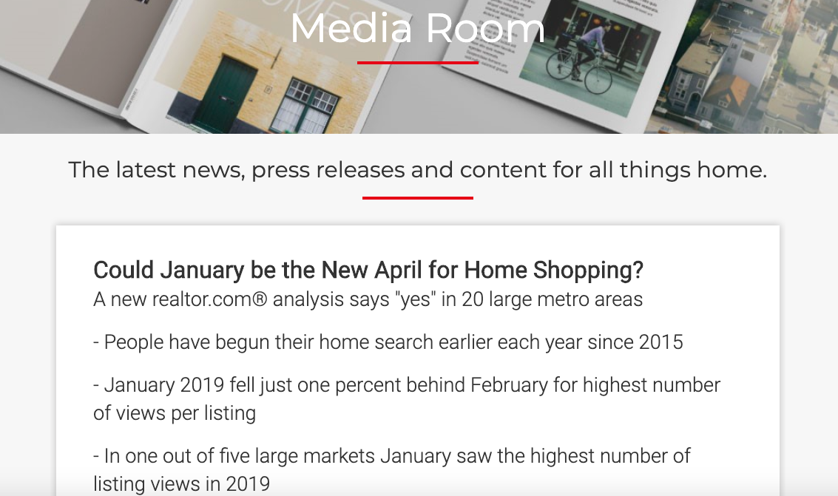

Slide 11
“Historically, April launched the kickoff of the home shopping season as buyers would come out of their winter hibernation looking for their new home. However, the spring shopping season now starts in January for many of the nation's largest markets, according to new research released today…”
12/18/19 Realtor.com
Notes:
https://www.housingwire.com/articles/goldman-sachs-predicts-global-expansion

Slide 13
Economists are Pushing Back Recession Timetable
Wall Street Journal Survey of Economists
Notes:
https://www.wsj.com/graphics/econsurvey/

Slide 14
Top 3 Triggers for Next Recession
Trade Policy
Stock Market Correction
Geopolitical Crisis
Coming in at #9…
Housing Slowdown
Notes:
https://pulsenomics.com/surveys/#home-price-expectations

Slide 15
% of home shoppers that expect a recession to occur in…
Updated August 2019
realtor.com
Notes:
https://news.move.com/2019-08-28-Home-Buyers-Gear-Up-for-Potential-2020-Recession

Slide 16
Will the U.S. housing market fare better or worse than the 2008 economic recession?
Updated August 2019
realtor.com
Notes:
https://news.move.com/2019-08-28-Home-Buyers-Gear-Up-for-Potential-2020-Recession

Slide 17
Percentage of consumers who would halt
their home search if a recession occurs
55
%
Updated August 2019
realtor.com
Notes:
https://news.move.com/2019-08-28-Home-Buyers-Gear-Up-for-Potential-2020-Recession

Slide 18
1991
2008
HOME PRICE CHANGE
during Last 5 Recessions
CoreLogic National Home Price Index
Notes:
https://www.corelogic.com/blog/2019/03/housing-recessions-and-recoveries.aspx

Slide 20
“People do not follow the best leaders. They follow the ones they can understand the easiest.”
Donald Miller

