Slide 2
TABLE OF CONTENTS

Slide 3
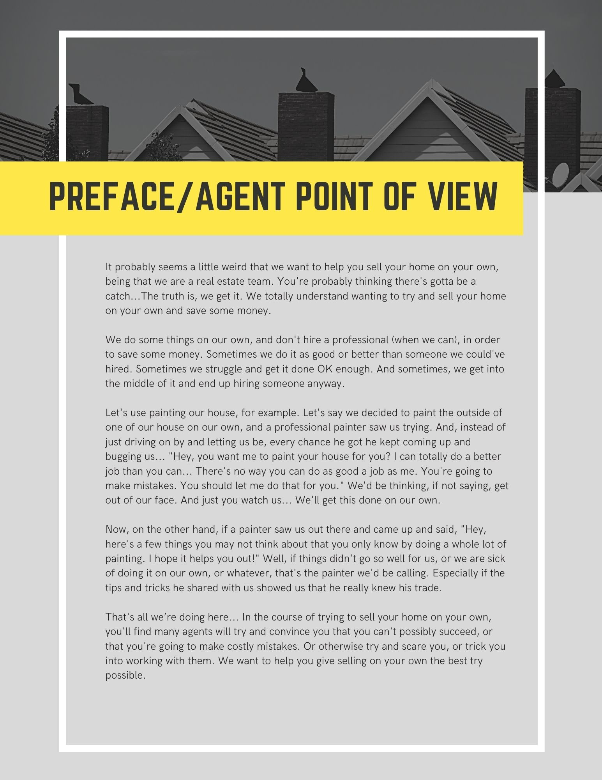
PREFACE/AGENTS POINT OF VIEW

Slide 4
PREFACE/AGENTS POINT OF VIEW

Slide 5
PRICING YOUR HOME

Slide 6
GOING ON THE MARKET

Slide 7
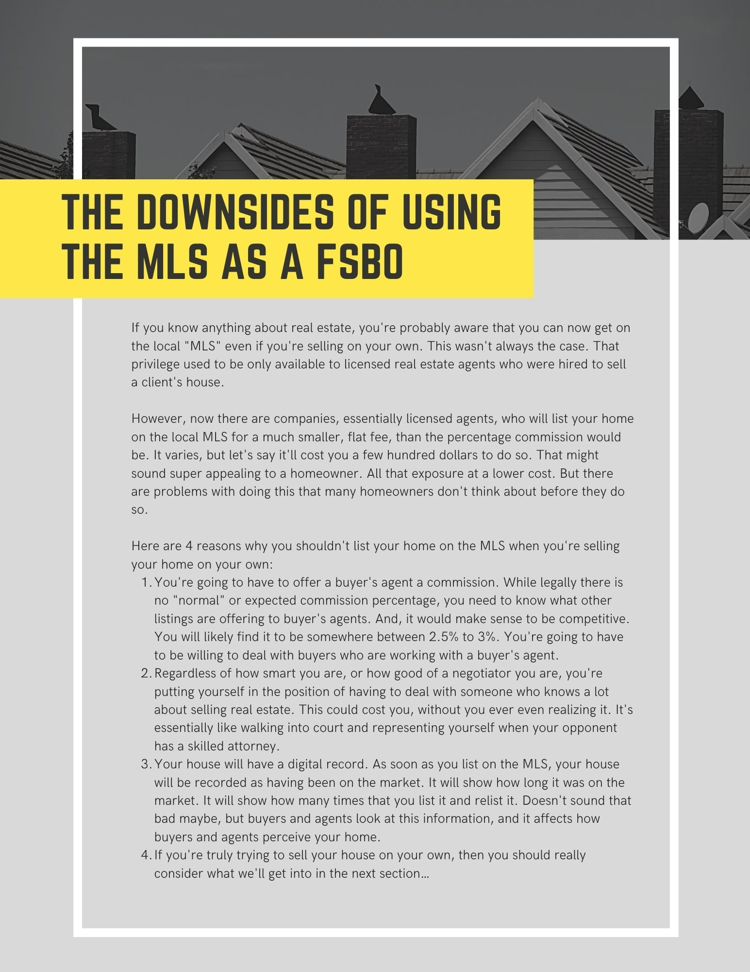
THE DOWNSIDES OF USING THE MLS AS A FSBO

Slide 8
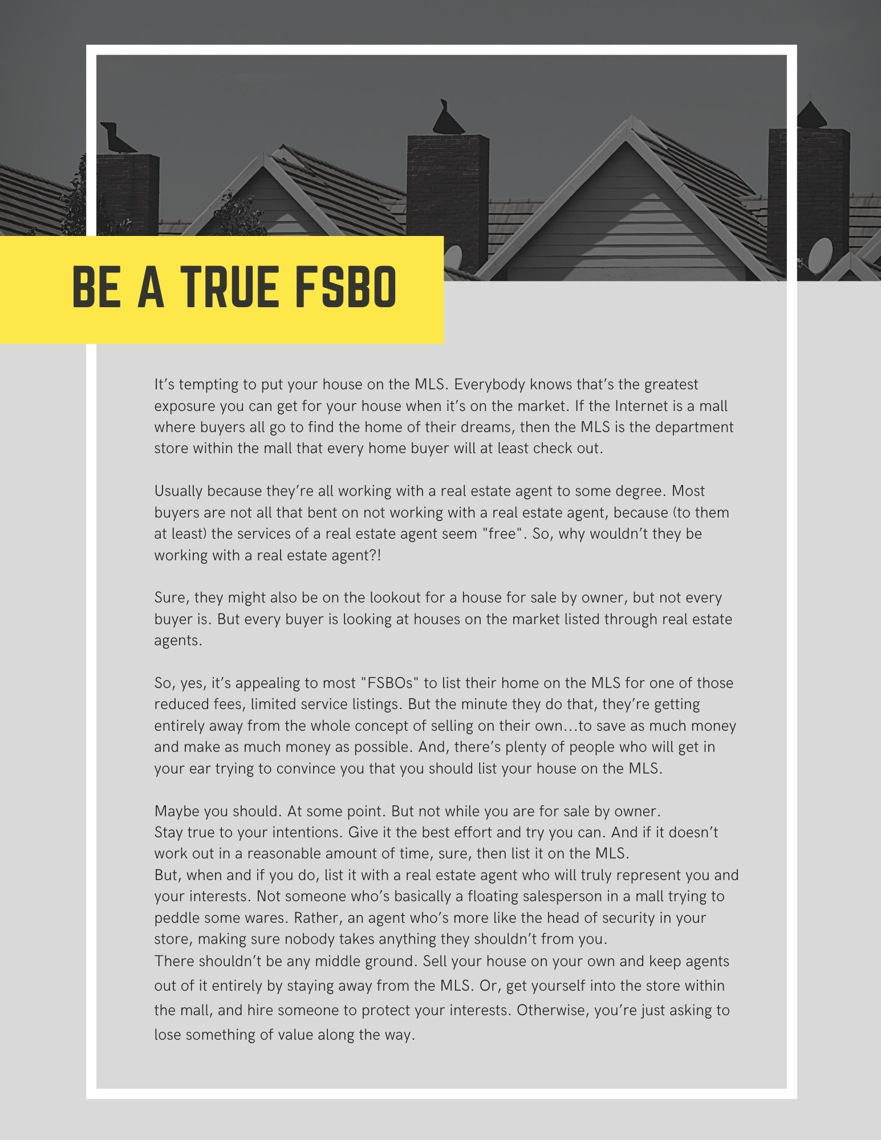
BE A TRUE FSBO

Slide 9
BE FAIR AND BE AWARE

Slide 10
BE CAREFUL HOW YOU DESCRIBE YOUR HOUSE

Slide 11
DISCLOSURES

Slide 12
DON’T OVER-SHOW YOUR HOUSE

Slide 13
OPEN HOUSES

Slide 14
12 OPEN HOUSE TIPS

Slide 15
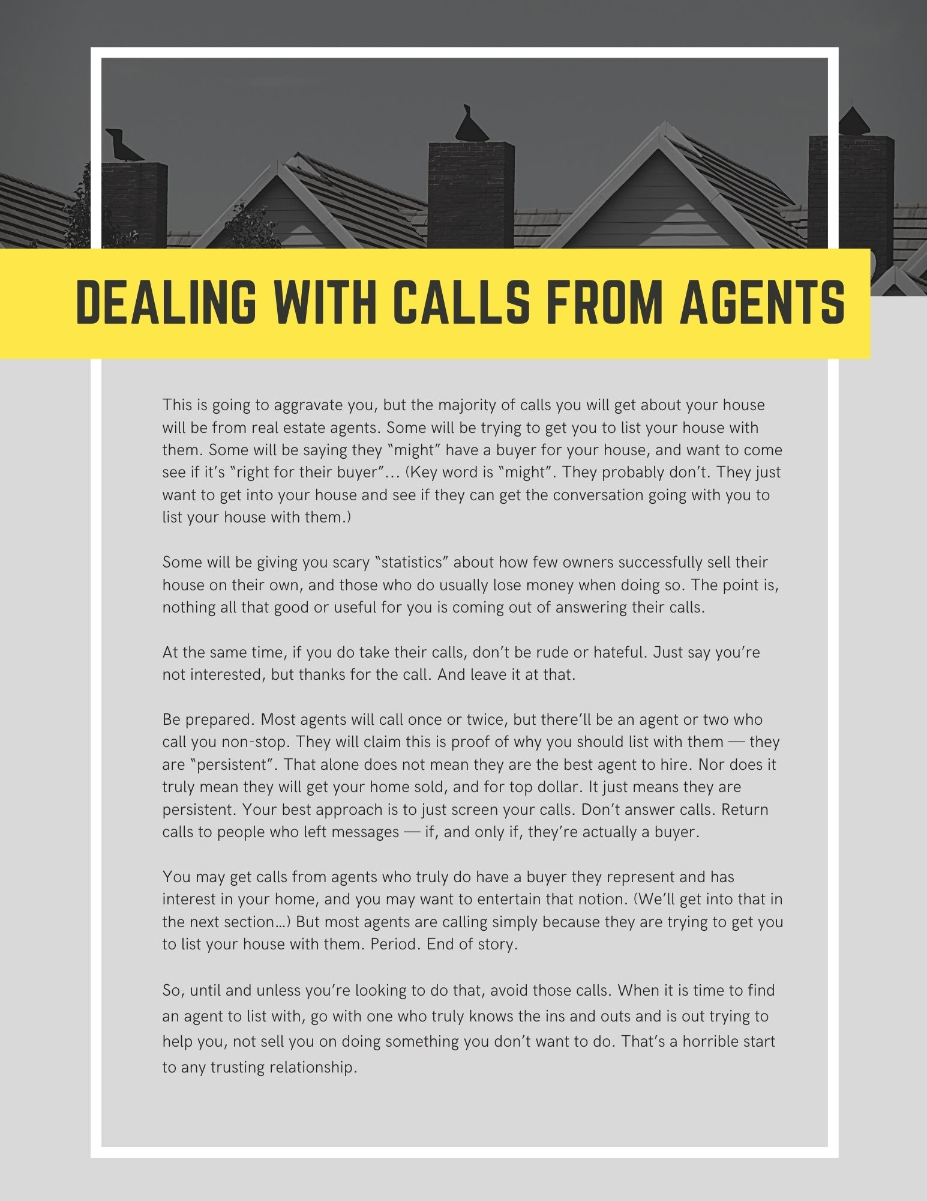
DEALING WITH CALLS FROM AGENTS

Slide 16
6 THINGS TO CONSIDER IF AN AGENT HAS A BUYER FOR YOUR HOME

Slide 17
WATCH THE MARKET WEEKLY

Slide 18
MAKE SURE YOUR PROSPECT/BUYER IS QUALIFIED

Slide 19
BUYERS WILL TRY TO PICK YOUR POCKET

Slide 20
D.B.D. x 2 = ?

Slide 21
NEGOTIATING

Slide 22
DEALING WITH BUYER’S REMORSE

Slide 23
WHAT’S THAT IN YOUR EAR?!

Slide 24
HOW EARNEST IS YOUR BUYER?

Slide 25
YOU CAN’T DO EVERYTHING YOURSELF

Slide 26
DEALING WITH INSPECTION ISSUES

Slide 27
DEALING WITH THE APPRAISAL

Slide 28
STAYING ON TOP OF THE MORTGAGE PROCESS

Slide 29
DON’T FORGET TOWN CERTIFICATIONS/INSPECTIONS

Slide 30
IF YOU’RE NOT HAVING ANY LUCK …

Slide 31
CONTACT US
ABC Realty Group
805-555-5555
info@ABCRealtyGroup.com
www.ABCRealtyGroup.com
We are a team of agents with over 40 years of combined experience. Our clients are the center of all we do in our business and we strive to make each transaction seamless. As a team we will communicate throughout the transaction and advocate for our clients.
We are a team of compassionate individuals made stronger by our faith, family and friendships. We support our community in which we live and work through action and deeds.
Our philosophy:
We believe the role as your Realtors® is to guide you through the buying or selling process, taking the time to make sure you understand every step of the transaction.
Comprehensive knowledge of the area:
Being residents of the area, we know the local communities very well and have extensive real estate experience. This in-depth knowledge of the area and the real estate market can help you make the most informed decisions.
Committed to ongoing training:
A wide variety of continuing training helps us deliver high-quality services to our customers and clients.
Dedicated to your needs:
Because real estate transactions don't stick to regular business hours, we are available seven days a week, coming in early and staying as late as necessary to get the job done.

